Slide 1
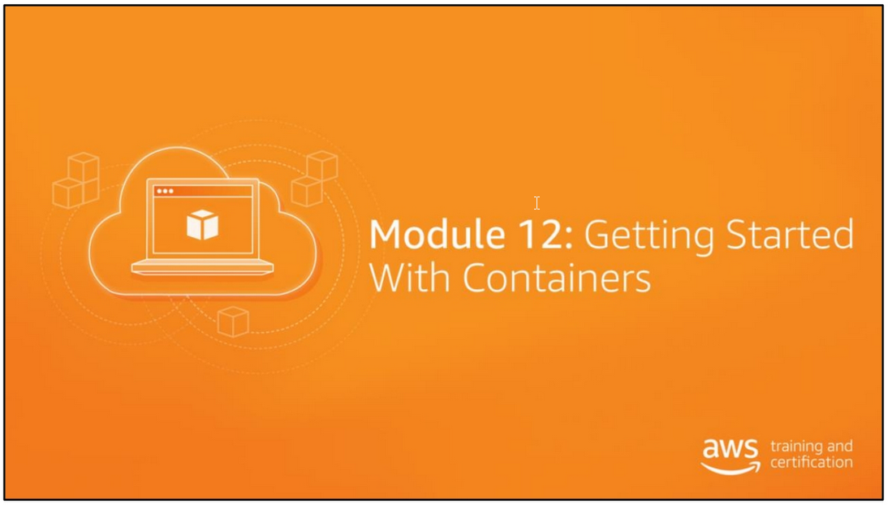

Slide 2
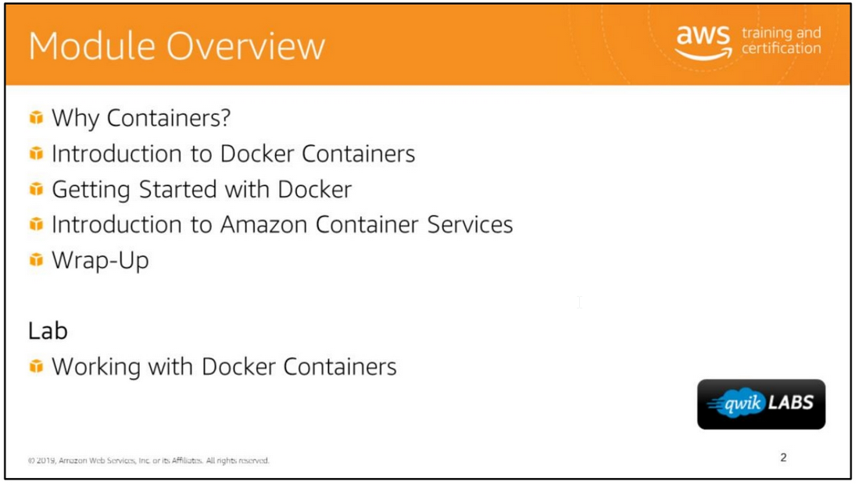

Slide 3
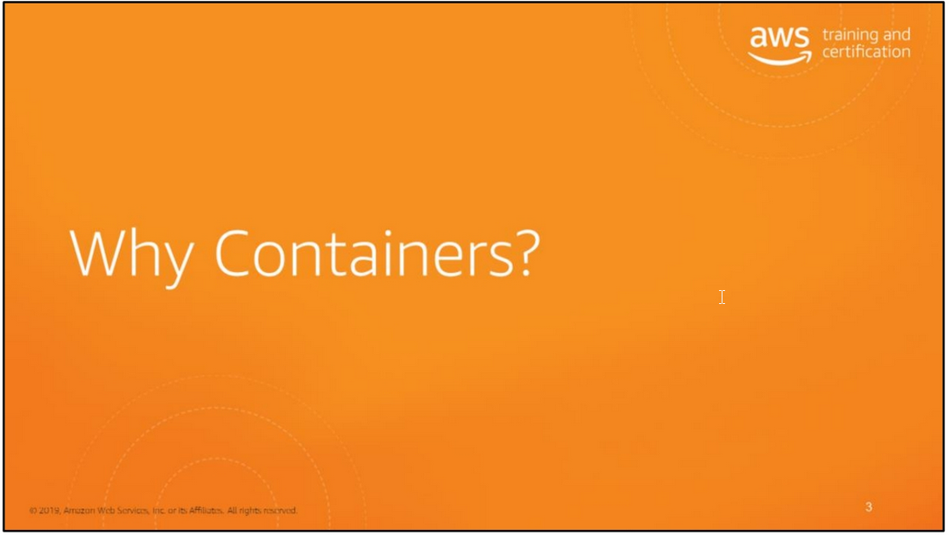

Slide 4
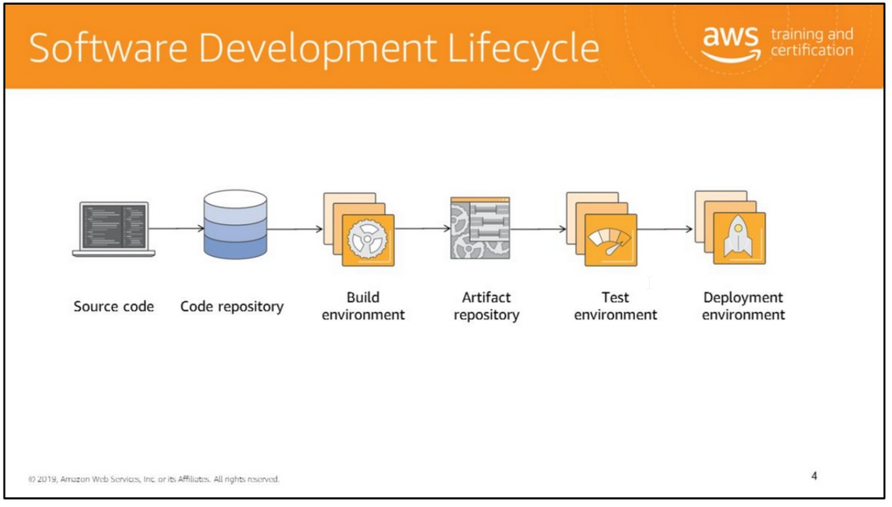

Slide 5
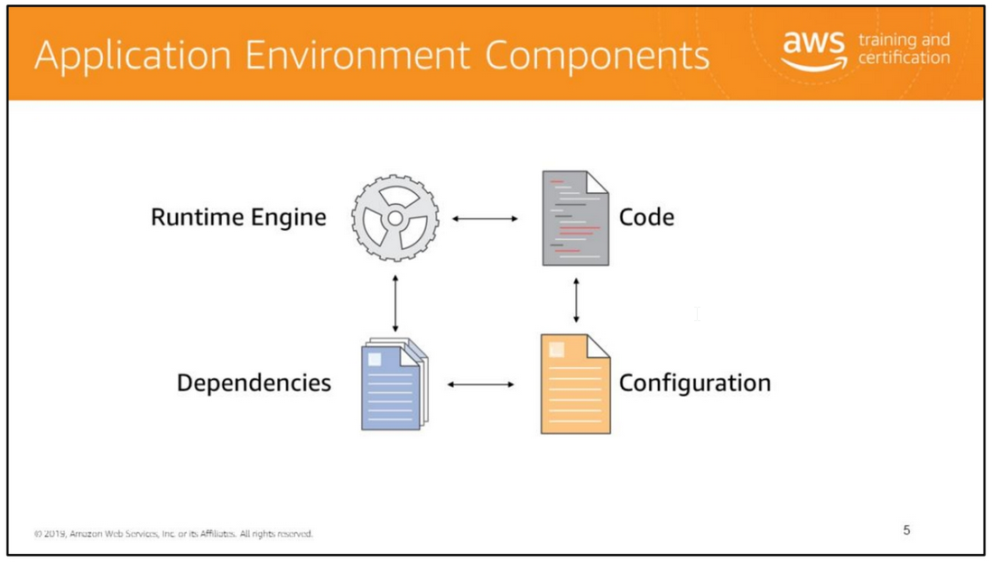
Containers are a method of operating system virtualization that allow you to run an application and its dependencies in resource-isolated processes.
Containers allow you to easily package an application's code, configurations, and dependencies into easy to use building blocks that deliver environmental consistency,
operational efficiency, developer productivity, and version control.

Slide 6
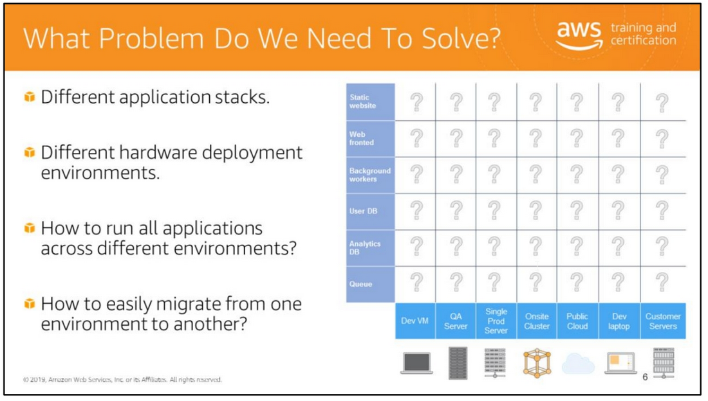
Prior to the introduction of containers, developers and administrators were often faced with a challenging web of complex compatibility restrictions, in which an application or workload
was built specifically for its predetermined environment. If this workload needed to be migrated, for example from bare metal to a virtual machine, or from a VM to the cloud,
or between service providers, then this generally meant rebuilding the application or workload entirely to ensure compatibility in the new environment.
Containers were conceived as an answer to this matrix of restriction and incompatibilities by providing a common interface for migrating applications between environments.
Challenges include:
• Existing architecture can’t handle extreme loads or scale easily.
• Independent development teams on different release schedules.
• Needed the ability for individual services to run multiple versions in production.
• Microservices architecture with a growing number of services and engineers

Slide 7
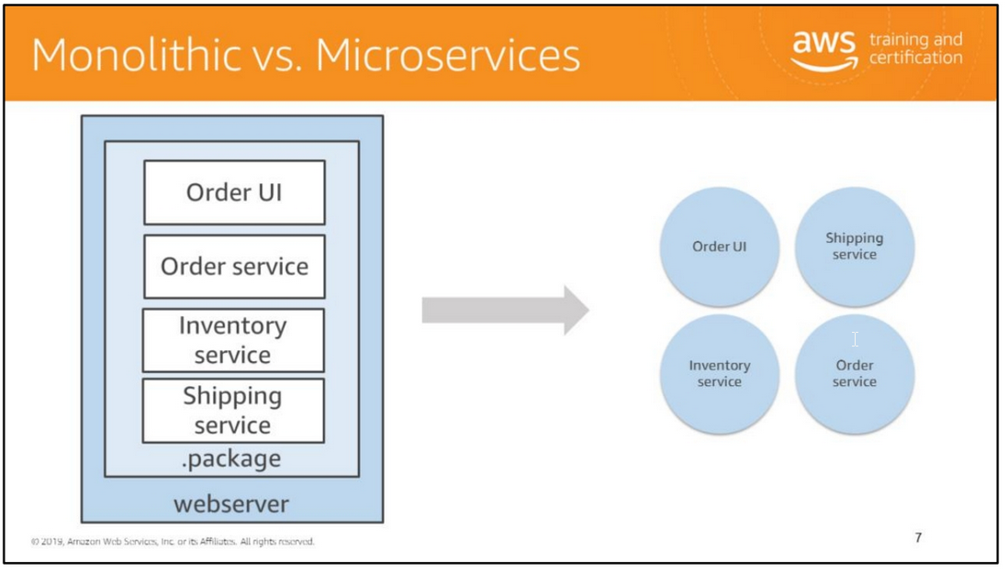
Let’s take a moment to look at the evolution of services to microservices. For example, many applications that utilize the Model View Controller Framework use a monolithic architecture.
The application is deployed as a single file (for example Java) or a collection of files rooted at the same directory (such as Rails).
All the application code runs in the same process. Scaling requires deploying multiple copies of the exact same application code to multiple servers.
There are a number of problems with the monolithic architecture. First, as features and services are added to the application, the code base will grow substantially more complex.
Because all the application code runs in the same process on the server, it is difficult (if not impossible) to scale individual portions of the application.
If one service is memory intensive and another CPU intensive, the server must be provisioned with enough memory and CPU to handle the baseline load for each service.
Finally, and more subtlety, the engineering team structure will often start to mirror the application architecture over time.
The microservices architecture is designed to address these issues.
The services defined in the monolithic application architecture are decomposed into individual services, and deployed separately from one another on separate hosts
Within a microservices architecture, each application component runs as its own service and communicates with other services via a well-defined API.
Microservices are built around business capabilities, and each service performs a single function.
Microservices can be written using different frameworks and programming languages, and you can deploy them independently, as a single service, or as a group of services.

Slide 8
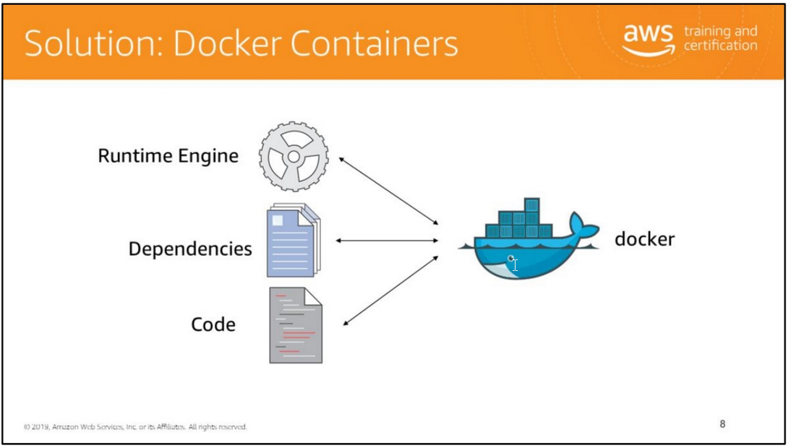
Containers allow you to easily package an application's code, configurations, and dependencies into easy to use building blocks that deliver environmental consistency,
operational efficiency, developer productivity, and version control.
Containers can help ensure that applications deploy quickly, reliably, and consistently regardless of deployment environment.

Slide 9
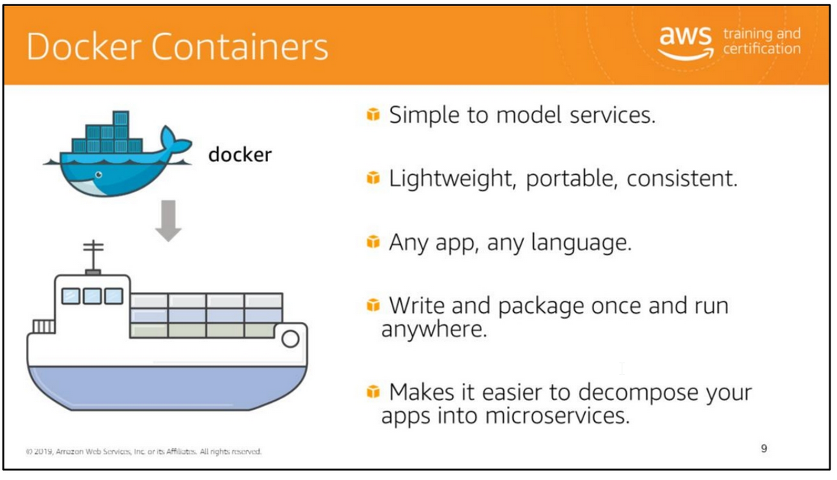

Slide 10
Containers are a perfect fit for microservices and solve the problems that were identified on an earlier slide.
Containers makes it easier to decompose your applications into microservices that can run side by side on the same instance.
Just as shipping containers standardized transport of freight goods, software containers aim to standardize the transport of applications. Ever see a stack of shipping containers on the back
of a truck or ship? Everyone has. It's funny to think that, just 50 years ago, these structures had only just been invented.
Prior to the introduction of the modern shipping container, merchants who wished to ship goods overseas used what is referred to as break-bulk shipping.
Goods were shipped in sacks, crates, cartons, drums, casks, barrels, and boxes of various weights, shapes, and sizes.
The lack of standardization made loading and unloading cargo time-consuming and cumbersome, forcing ships to spend long times moored at port.
It also resulted in frequent cargo theft and damage. In 1956, a man named Malcom McLean began hauling goods in standard-sized container boxes.
The boxes were much easier to load and unload. Ships could be overhauled or designed so that these boxes could be stacked efficiently one on top of the other.
The system proved so popular that an ISO standard was created to standardize the size, capacity, and latching mechanisms for containers so that they could be easily moved
between ships, trucks, and railroad cars created by different manufacturers.
The people who created Docker asked themselves:
Why can't we do the same thing for software applications? Indeed, software applications are still in much the same state as shipping containers were 50 years ago.
Every developer is familiar with how difficult it is to make an application that works perfectly well on a development box function equally well in testing, staging, or production.
One of the largest headaches experienced by new developers on a large software development project is getting the build to work on their local machines.
The bright idea of the people behind Docker was to create a container that contained everything a software application would need to run - all of its files, file system structure, daemons, libraries, and application dependencies. Let's see in the subsequent slides exactly how this works.
By using containers, you decouple applications from operating systems.
This ensures that users have a clean Linux operating system and can run everything else in an isolated container.
The Linux kernel features - cgroups and namespaces, create walls between containers and other processes running on the host. Linux namespaces, wrap a set of system resources
and present them to a process to make it look like they are dedicated to that process.
Linux cgroups, govern the isolation and usage of system resources, such as CPU and memory, for a group of processes.
For example, if you have an application that takes up a lot of CPU cycles and memory, such as a scientific computing application,
you can put the application in a group to limit its CPU and memory usage.
Namespaces deal with resource isolation for a single process, while cgroups manage resources for a group of processes.
Sources: http://www.worldshipping.org/about-the-industry/history-of-containerization/the-birth-of-intermodalism.

Slide 11
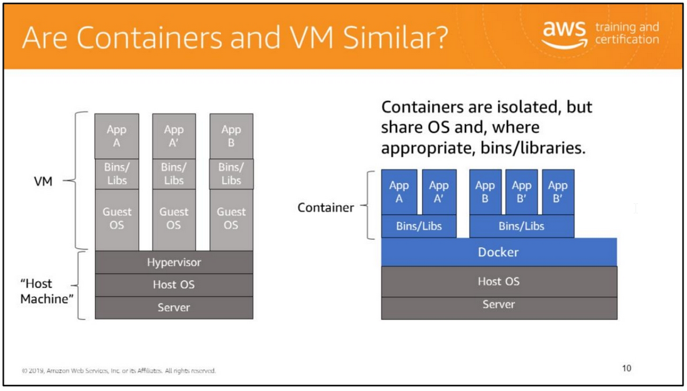
When hearing the capabilities of containers, it is somewhat intuitive to think that it sounds just like a virtual machine. However, the differences are in the details.
The number one difference is the lack of a hypervisor requirement. Containers can run on any Linux system with appropriate kernel feature support and the Docker daemon present.
This makes them extremely portable. Your laptop, your VM, your EC2 instance, and your bare metal server are all potential hosts.
The lack of a hypervisor requirement also results in almost no noticeable performance overhead.
The processes are talking directly to the kernel and are largely unaware of their container silo.
Most containers boot in just a couple of seconds.
Where VMs are isolated at the operating system level, containers are isolated at the kernel level.
This means that several applications can run on a single host operating system, and yet still have their own file system, storage, RAM, libraries, essentially, their own "view" of the system.

Slide 12
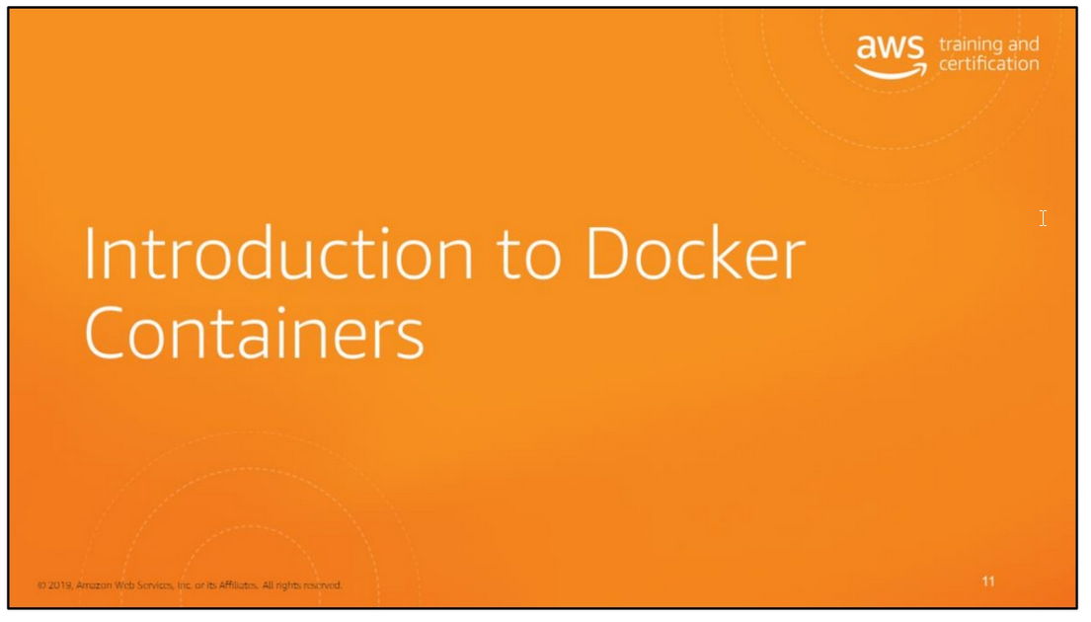

Slide 13
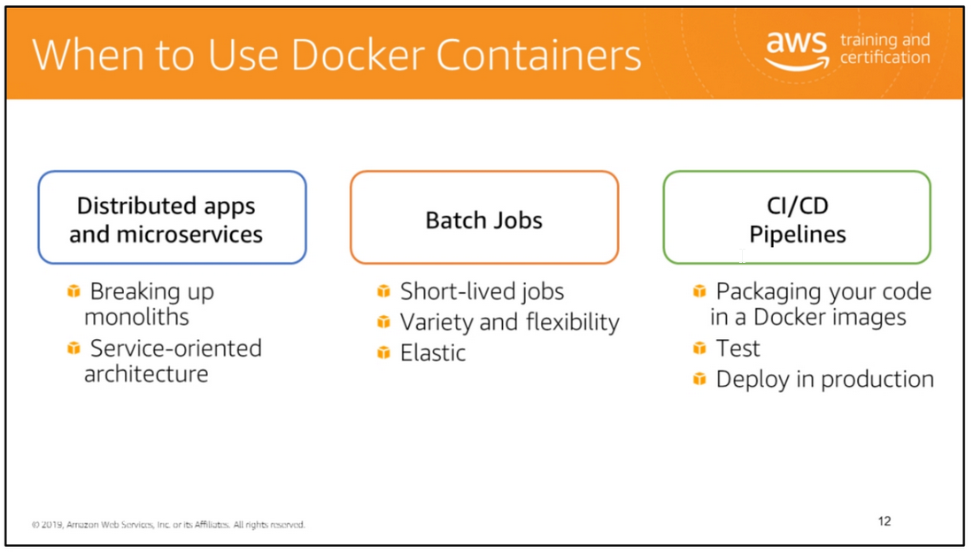
Containers in general are perfect for microservices and Amazon ECS further simplifies such architectures:
• Containers make services easy to model in an immutable image with all of your dependencies.
• Containers can use any application and any programming language.
• The container image is a versioned artifact, so you can track your container images to the source they came from.
• You can test your containers locally, and deploy the same artifact to scale.
Batch Jobs
Docker containers are suited for batch job workloads. Batch jobs are often short-lived and embarrassingly parallel.
You can package your batch processing application into a Docker image so that you can deploy it anywhere, such as in Amazon ECS.
CI/CD
Continuous integration and continuous deployment (CICD) is a common process that are based on Docker containers. You can create a pipeline that takes the following actions:
• Monitors changes to a source code repository
• Builds a new Docker image from that source
• Pushes the image to an image repository such as Amazon ECR or Docker Hub
• Updates your Amazon ECS services to use the new image in your applicatio

Slide 14
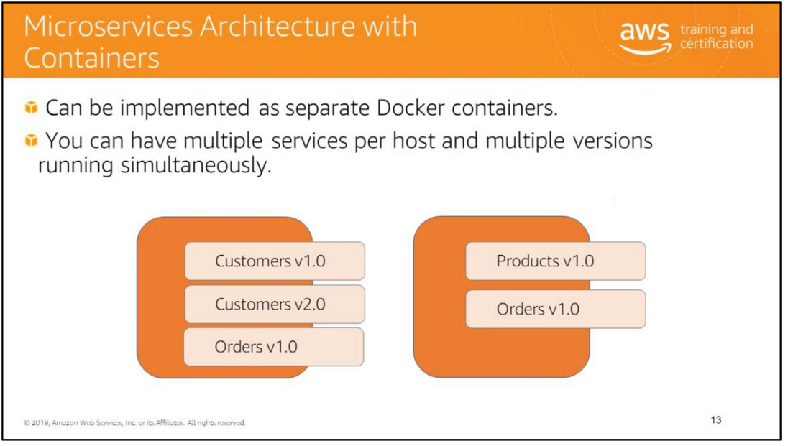
Using Docker, all of the different tiers of your Web application architecture could be constructed as independent Docker containers.
If you are deploying a microservices architecture, you could implement each service as its own separate Docker container.
Such an approach has several advantages:
You can distribute running services across instances on an Amazon EC2 fleet.
• You can run multiple services on a single Amazon EC2 instance within your fleet. This allows maximizing the CPU and memory usage of your existing instances.
• You can run multiple different versions of a service simultaneously - even on the same machine, assuming that they bind to different ports.
This allows you to release breaking changes in services while retaining backward compatibility with applications that may not have yet been modified to work against the new version.

Slide 15
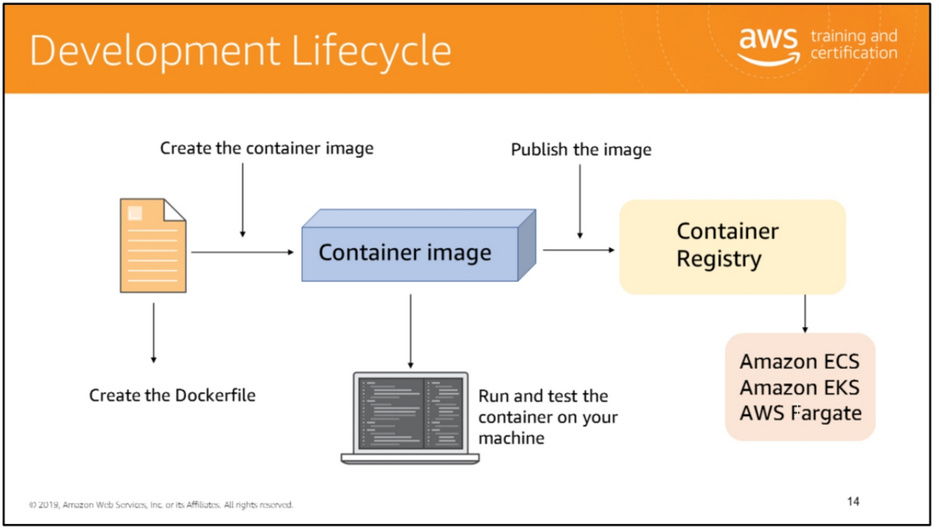
To deploy applications on Amazon ECS, your application components must be architected to run in containers.
A Docker container is a standardized unit of software development, containing everything that your software application needs to run: code, runtime, system tools, system libraries, etc.
Containers are created from a read-only template called an image.
Images are typically built from a Dockerfile, a plaintext file that specifies all of the components that are included in the container.
These images are then stored in a registry from which they can be downloaded and run on your cluster.

Slide 16
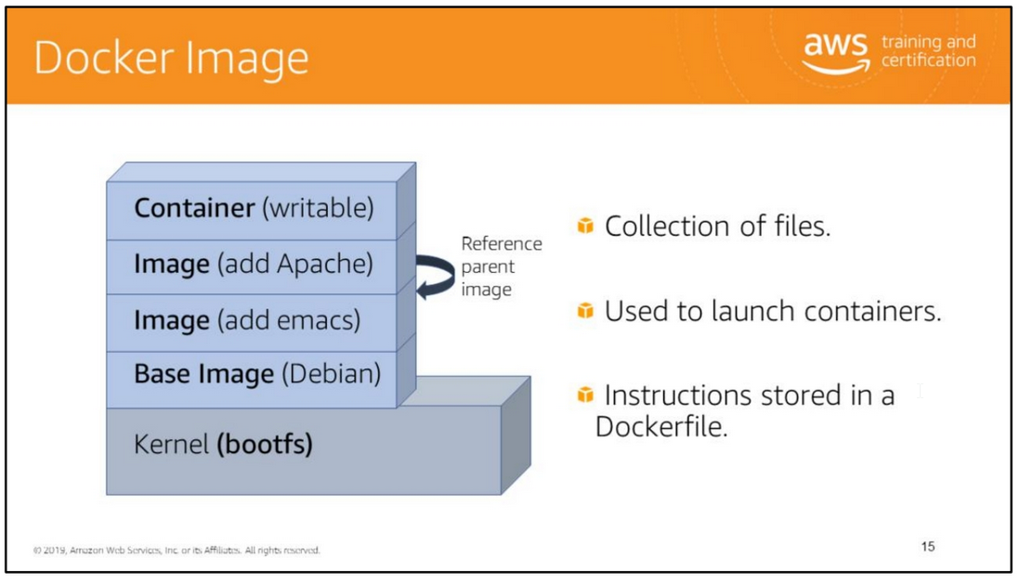
A Docker image is a collection of files. Base images (Debian, Ubuntu, busybox, fedora, etc.) are what you build your own custom images on top of.
Images are layered and each layer represents a diff (or what changed) from the previous layer. Each Docker image is actually a stack of images.
Each layer itself is an image.
When Docker mounts the rootfs, it starts read-only, as in a traditional Linux boot, but then, instead of changing the file system to read-write mode,
it takes advantage of a union mount to add a read-write file system over the read-only file system.
In fact there may be multiple read-only file systems stacked on top of each other.

Slide 17
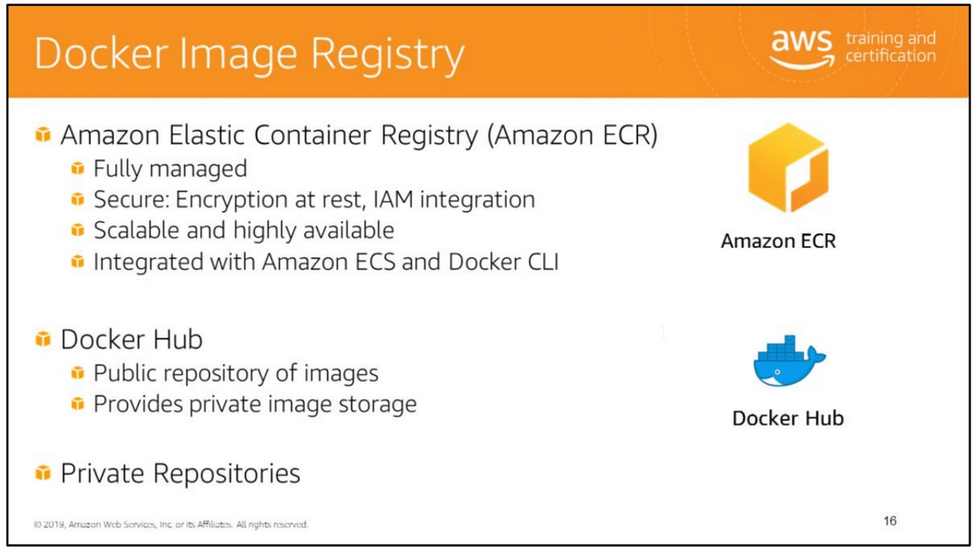
Amazon Elastic Container Registry (Amazon ECR) is a fully-managed Docker container registry that makes it easy for you to store, manage, and deploy Docker container images.
Amazon ECR can be used standalone and also has deep integration with Amazon ECS, simplifying your development to production workflow.
Amazon ECR eliminates the need to operate your own container repositories or worry about scaling the underlying infrastructure.
Amazon ECR hosts your images in a highly available and scalable architecture, allowing you to reliably deploy containers for your applications.
Amazon ECR eliminates the need to operate and scale the infrastructure required to power your container registry.
Amazon ECR uses Amazon S3 for storage to make your container images highly available and accessible, allowing you to reliably deploy new containers for your applications.
Amazon ECR transfers your container images over HTTPS and automatically encrypts your images at rest.
You can configure policies to manage permissions for each repository and restrict access to IAM users, roles, or other AWS accounts.
Amazon ECR integrates with Amazon ECS and the Docker CLI, allowing you to simplify your development and production workflows.
You can easily push your container images to Amazon ECR using the Docker CLI from your development machine, and Amazon ECS can pull them directly for production deployments.

Slide 18
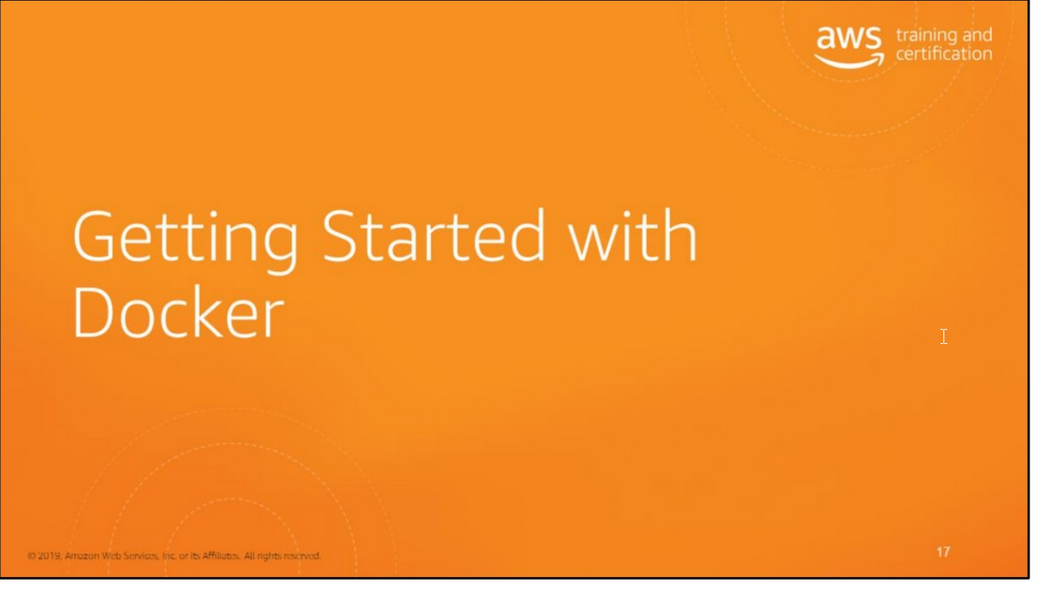

Slide 19
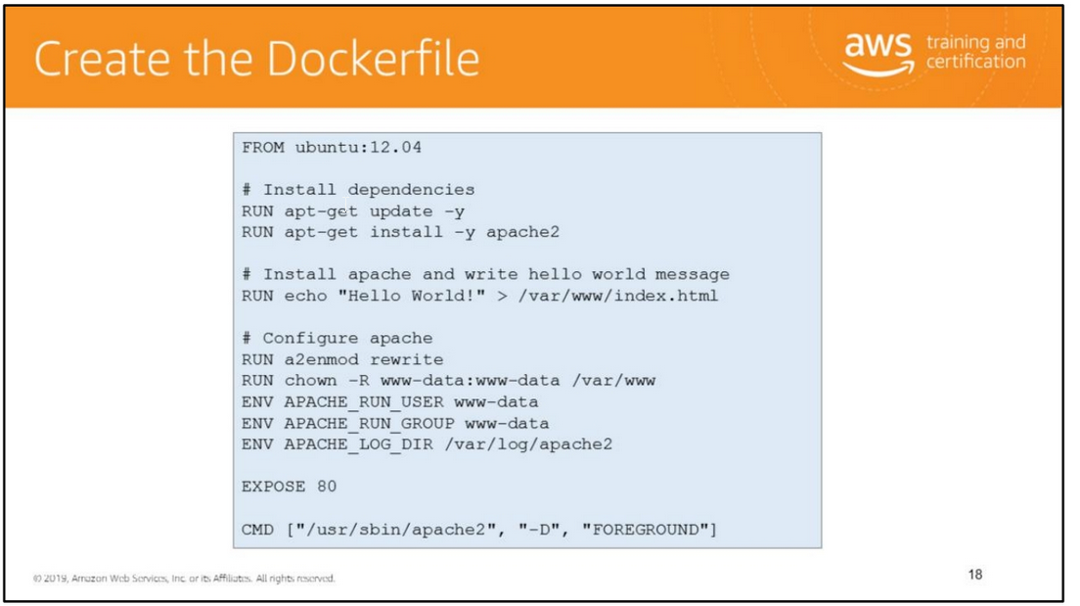

Slide 20
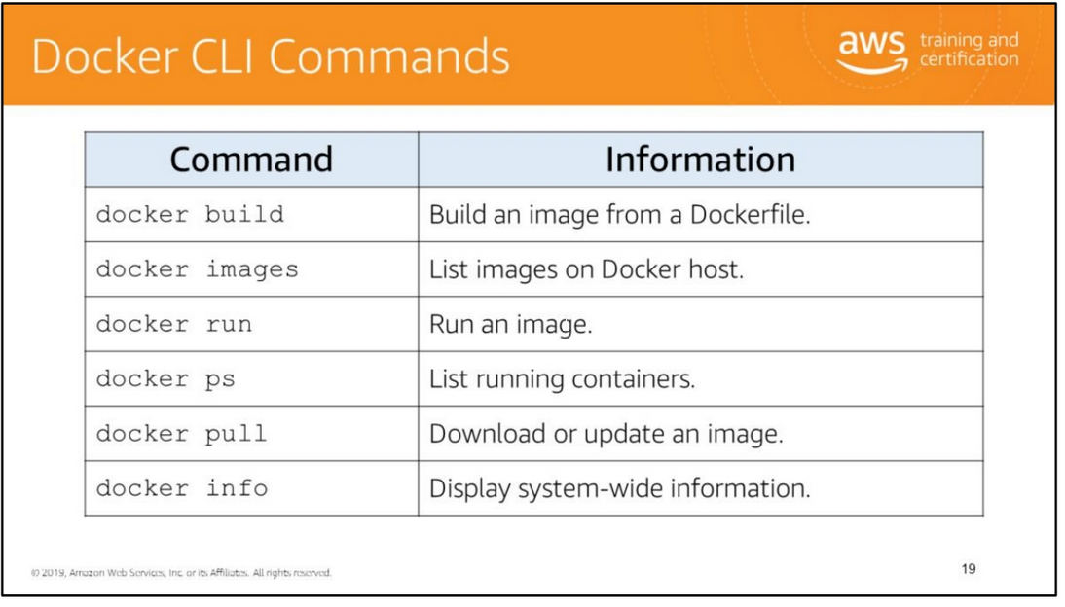

Slide 21
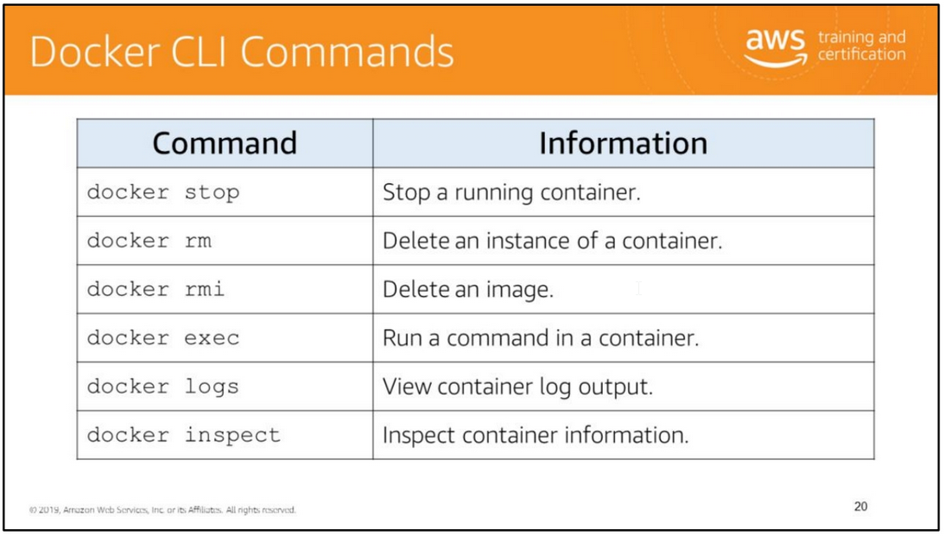

Slide 22
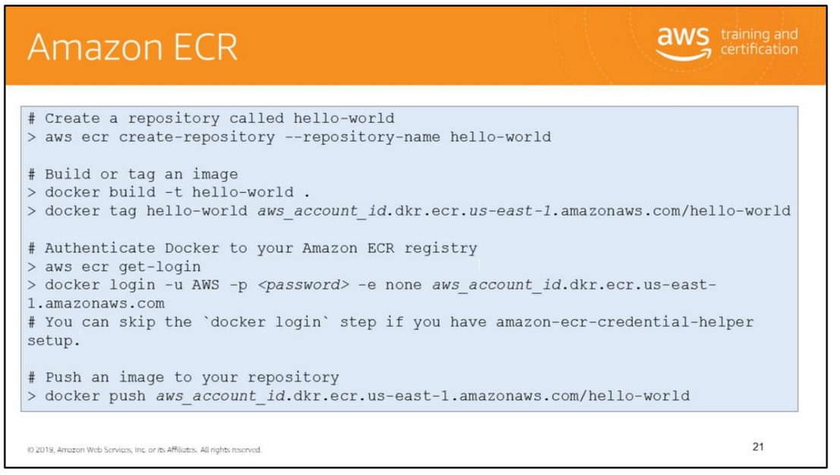
Amazon ECR is a managed AWS Docker registry service. Amazon ECR provides a command line interface and APIs to create, monitor, and delete repositories and set repository permissions.
You can perform the same actions in the Amazon ECR Management Console, which can be accessed via the “Repositories” section of the Amazon ECS Console.
Amazon ECR also integrates with the Docker CLI allowing you to push, pull, and tag images on your development machine.
Amazon ECR provides a secure, scalable, and reliable registry.
Amazon ECR supports private Docker repositories with resource-based permissions using AWS IAM so that specific users or Amazon EC2 instances can access repositories and images.
Developers can use the Docker CLI to author and manage images. For information on Authenticating Amazon ECR Repositories for Docker CLI with Credential Helper, see
https://aws.amazon.com/blogs/compute/authenticating-amazon-ecr-repositories-for-docker-cli-with-credential-helper/.

Slide 23
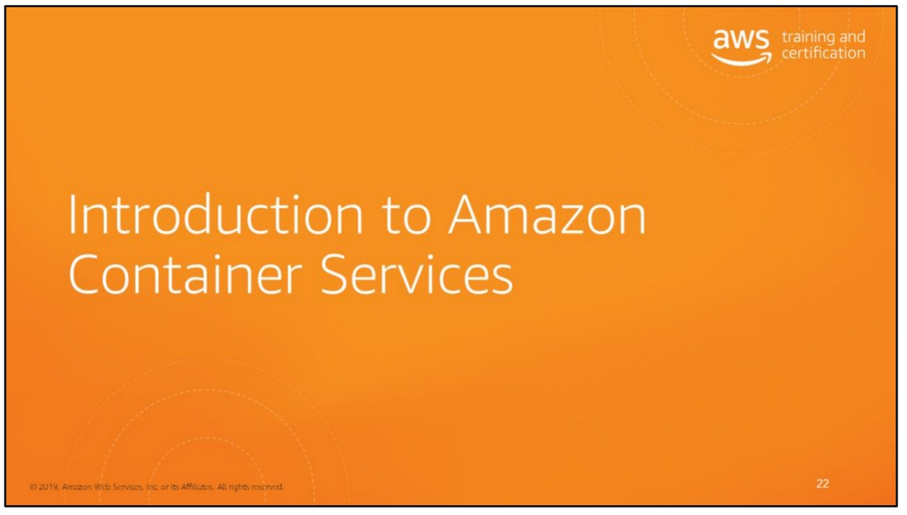

Slide 24
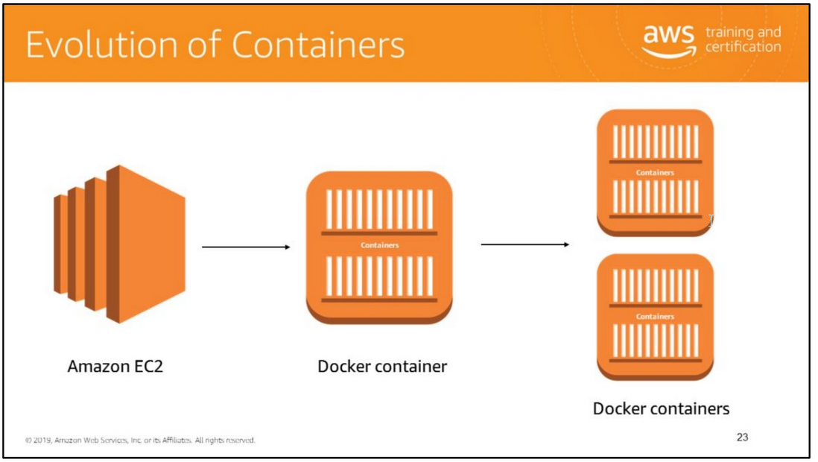
First, there was Amazon EC2. Next, came Docker containers where customers started containerizing applications within EC2 instances.
Running one container is fine and rightfully so, you might think to use them a lot. So you add another container.
Maybe add a few more that you can still manage.

Slide 25
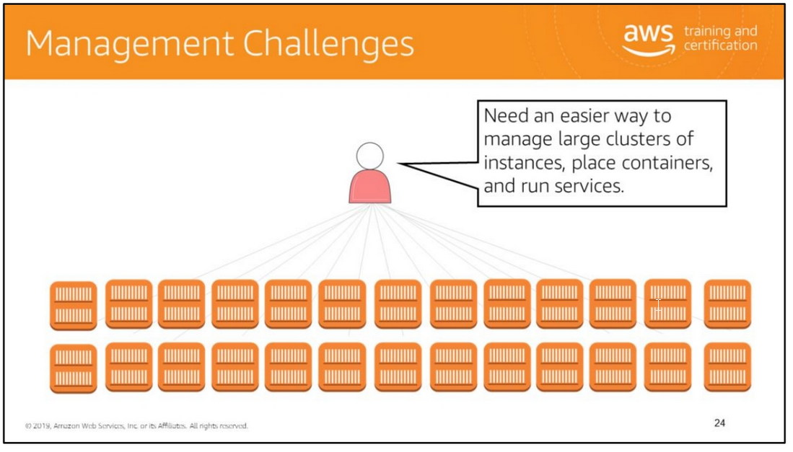
What about when you have a fleet and each of container is an application with different lifecycles, needs, customizations?
What about the infrastructure that’s running them?
You need to figure out a way to manage containerized applications at scale, still leveraging though the same levels of flexibility that a container gives you.
Also, you want to secure your computing platform, making sure that you still have control on customers and operators that are consuming the platform.
Now you’re suddenly managing a cluster and cluster management is hard.
You need a way to intelligently place your containers on the hosts that have the resources and that means you need to know the state of everything in your system.

Slide 26
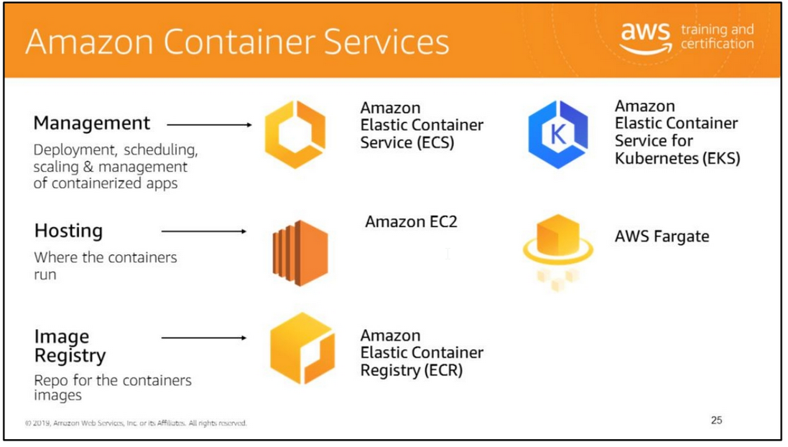
Containers are an increasingly important way for developers to package and deploy their applications.
They are lightweight and provide a consistent, portable software environment for applications to easily run and scale anywhere.
Building and deploying microservices, running batch jobs, for machine learning applications, and moving existing applications into the cloud are just some of the popular use cases for containers.
AWS offers multiple container products to help you deploy, manage, and scale containers in production.
There are a number of ways to run containers on AWS, including Amazon Elastic Container Service (ECS) is a highly scalable, high performance container management service.
AWS Fargate is a technology for Amazon ECS that lets you run containers in production without deploying or managing infrastructure.
Amazon Elastic Container Service for Kubernetes (EKS) makes it easy for you to run Kubernetes on AWS.
AWS Fargate is technology for Amazon ECS that lets you run containers without provisioning or managing servers.
Amazon Elastic Container Registry (ECR) is a highly available and secure private container repository that makes it easy to store and manage your Docker container images,
encrypting and compressing images at rest so they are fast to pull and secure

Slide 27
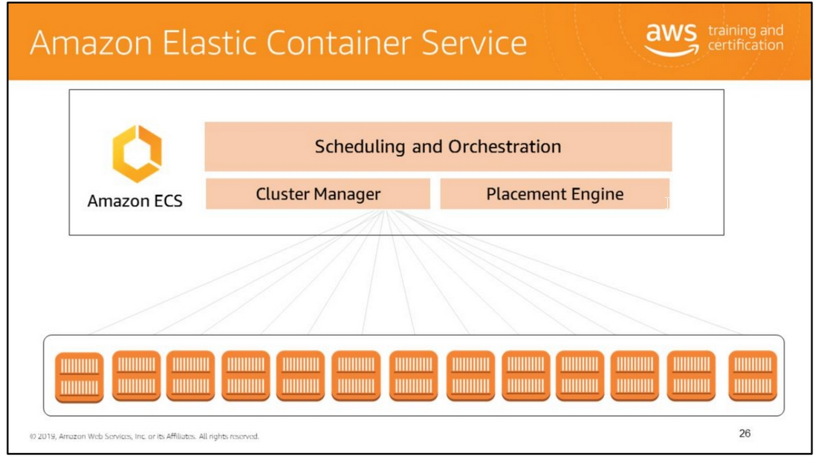
Amazon Elastic Container Service (Amazon ECS) is a fully-managed container orchestration service that helps you easily deploy, manage, and scale containerized applications on AWS.
With Amazon ECS, you do not have to install and operate your own container orchestration software, manage and scale a cluster of virtual machines, or schedule containers
on those virtual machines. Amazon ECS is designed from the ground up to be deeply integrated with the rest of the AWS platform, working with services
like Amazon Elastic Load Balancer, IAM, Amazon ECR, CloudWatch, AWS CloudFormation, and CloudTrail.
With Amazon ECS, you get a highly reliable solution that provides a native AWS API experience for containers, similar to EC2 for virtual machines.
Amazon ECS:
• Manages the execution of containerized application in a highly available manner.
• Manages clusters of EC2 Instances supporting Docker containers.
• Monitors resource consumption and availability requirements

Slide 28
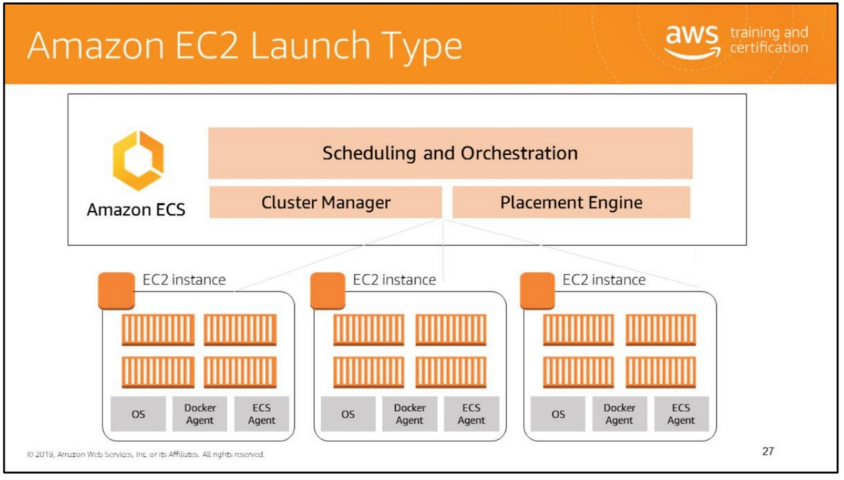

Slide 29
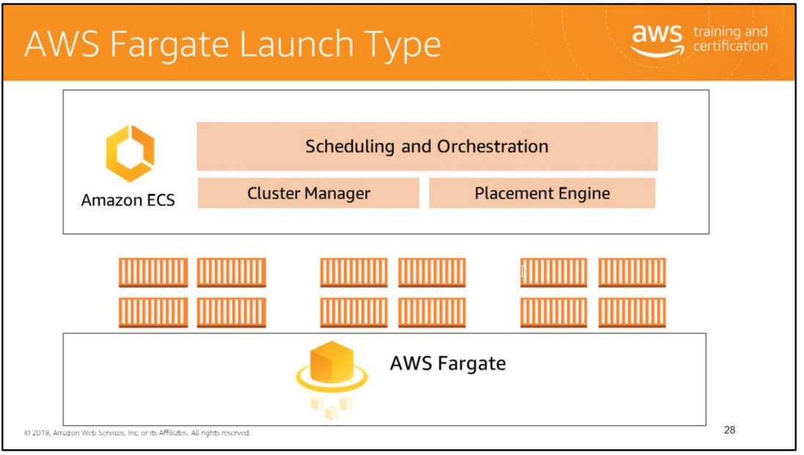
AWS Fargate is a technology for deploying and managing containers without having to manage any of the underlying infrastructure.
You no longer have to provision, configure, and scale clusters of virtual machines to run containers.
Simply upload your container image, specify resource requirements, and AWS Fargate launches containers for you within seconds.
AWS Fargate enables you to focus on designing and running the application, not the infrastructure.
AWS Fargate enables developers to focus 100% on their applications. With AWS Fargate, instance management goes away.
The Fargate launch type only supports using container images hosted in Amazon ECR or publicly on Docker Hub. Private repositories are currently only supported using the EC2 launch type.

Slide 30
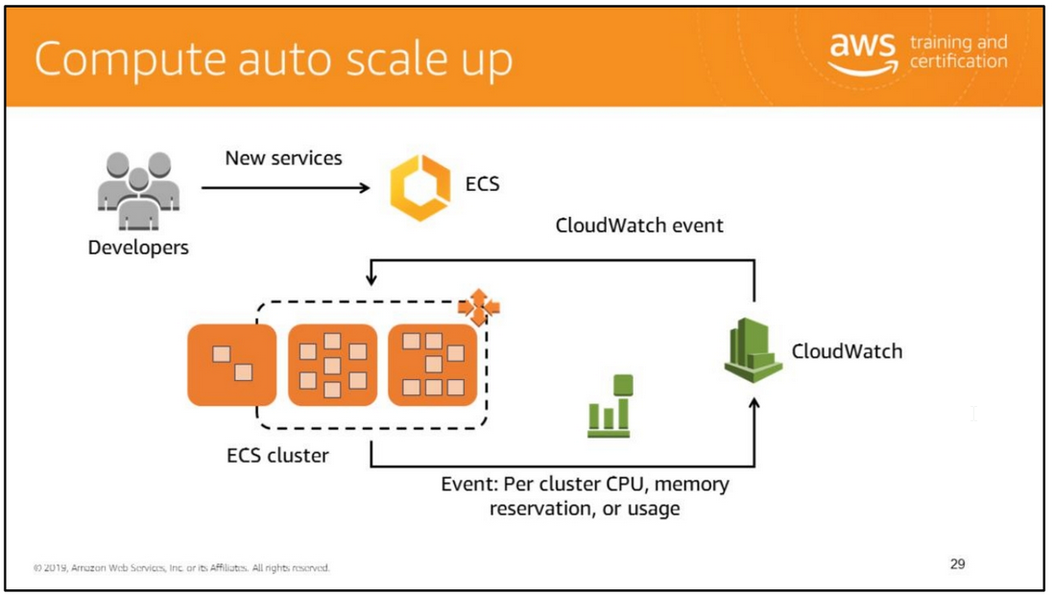

Slide 31
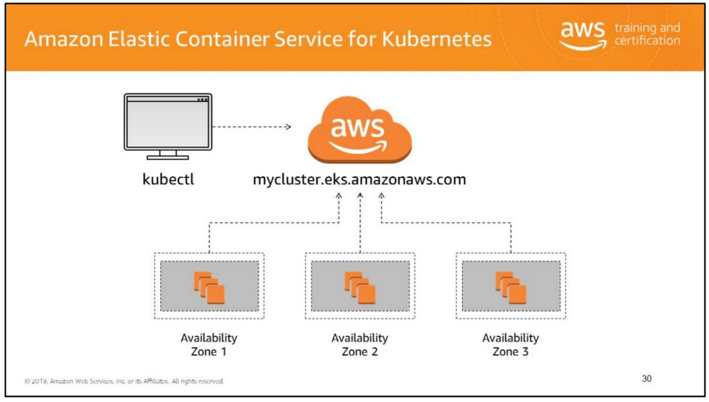
Kubernetes is open source software that allows you to deploy and manage containerized applications at scale.
Kubernetes groups containers into logical groupings for management and discoverability, then launches them onto clusters of EC2 instances.
Using Kubernetes you can run containerized applications including microservices, batch processing workers, and platforms as a service (PaaS) using the same toolset
on premises and in the cloud.
Amazon Elastic Container Service for Kubernetes (Amazon EKS) is a managed service that makes it easy for you to run Kubernetes on AWS without needing to become an expert
in operating Kubernetes. Amazon EKS runs the Kubernetes management infrastructure for you across multiple AWS Availability Zones to eliminate a single point of failure.
Amazon EKS is certified Kubernetes conformant so you can use existing tooling and plugins from partners and the Kubernetes community.
Applications running on any standard Kubernetes environment are fully compatible and can be easily migrated to Amazon EKS.
Amazon EKS provisions and scales the Kubernetes control plane, including the API servers and backend persistence layer, across multiple AWS availability zones for high availability
and fault tolerance. Amazon EKS automatically detects and replaces unhealthy control plane nodes and provides patching for the control plane.
Amazon EKS is integrated with many AWS services to provide scalability and security for your applications.
These services include Elastic Load Balancing for load distribution, IAM for authentication, Amazon VPC for isolation, AWS PrivateLink for private network access, and AWS CloudTrail for logging.

Slide 32
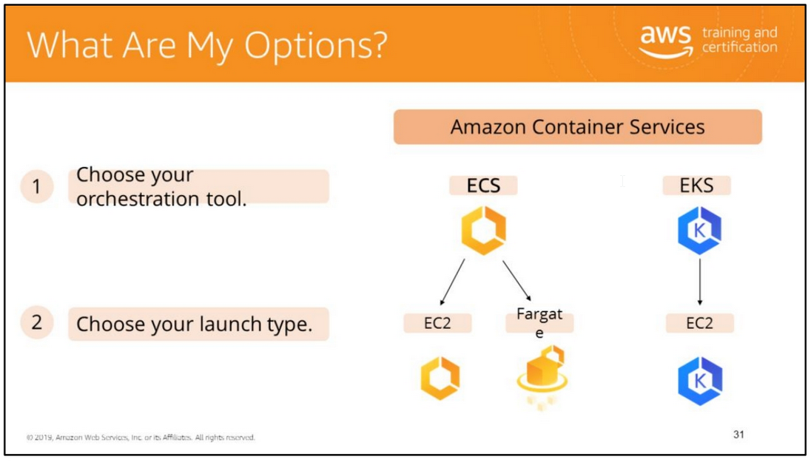

Slide 33

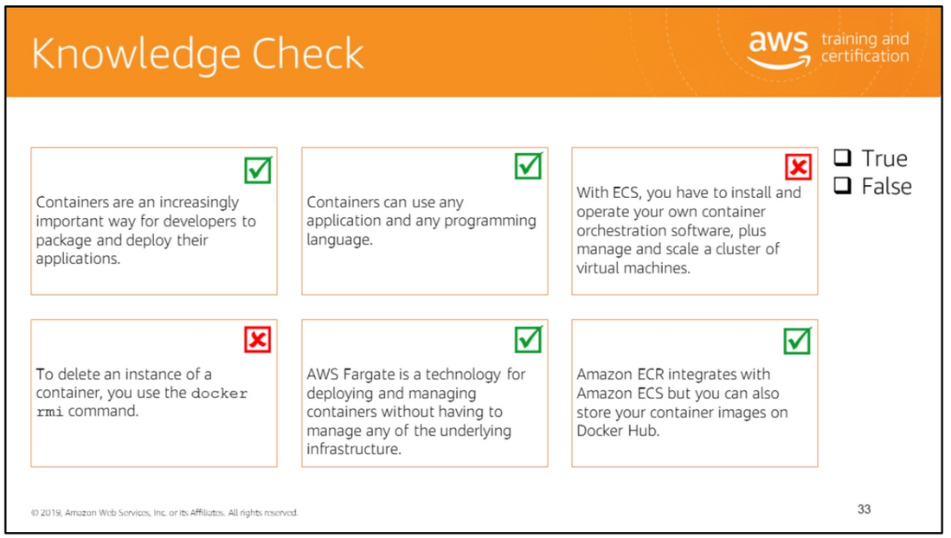
Read left to right:
(True)
(True)
(False) With ECS, you do not have to install and operate your own container orchestration software, manage and scale a cluster of virtual machines.
(False) To delete an instance of a container, you use the docker rm command. To delete an image, you use the docker rmi command.
(True)
(True)

Slide 34
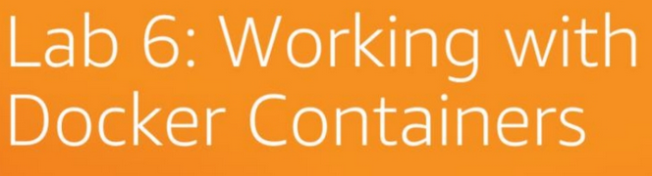
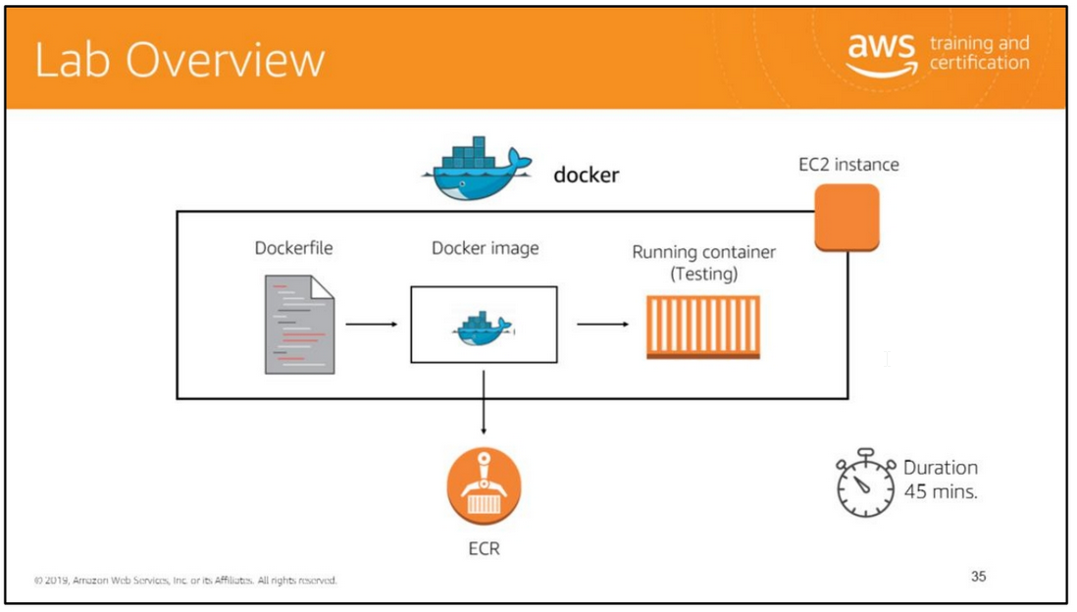
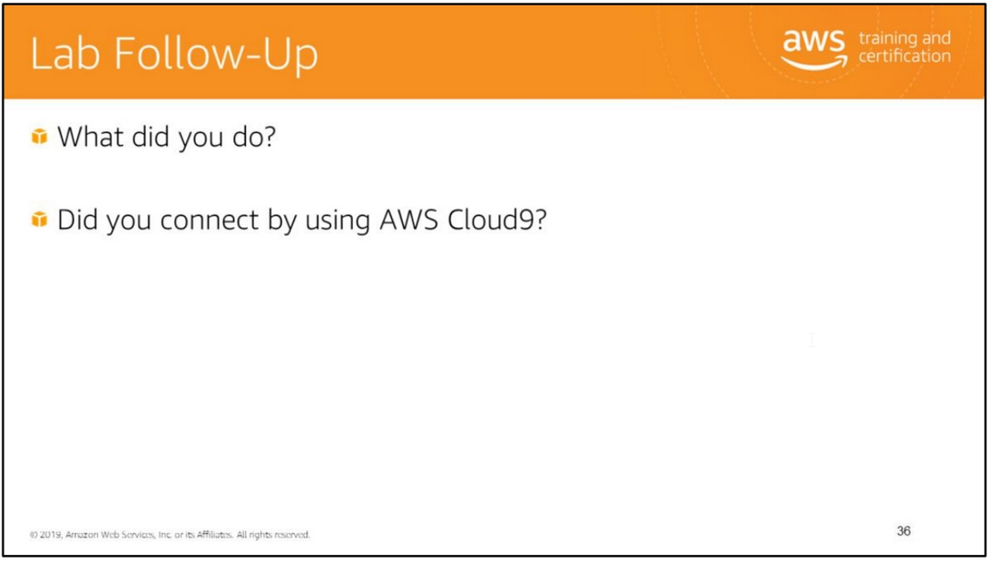
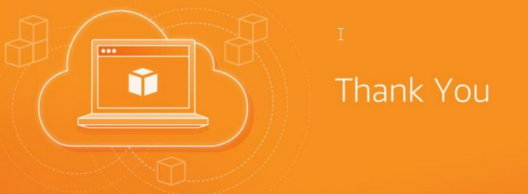
In this lab, you will:
• Launch an EC2 instance with user-data
• Create a Dockerfile
• Create a Docker image using a dockerfile
• Run a container from a Docker image
• Interact with and administer your containers
• Create an ECR Repository
• Authenticate the Docker client to ECR
• Push a Docker image to ECR

Slide 35
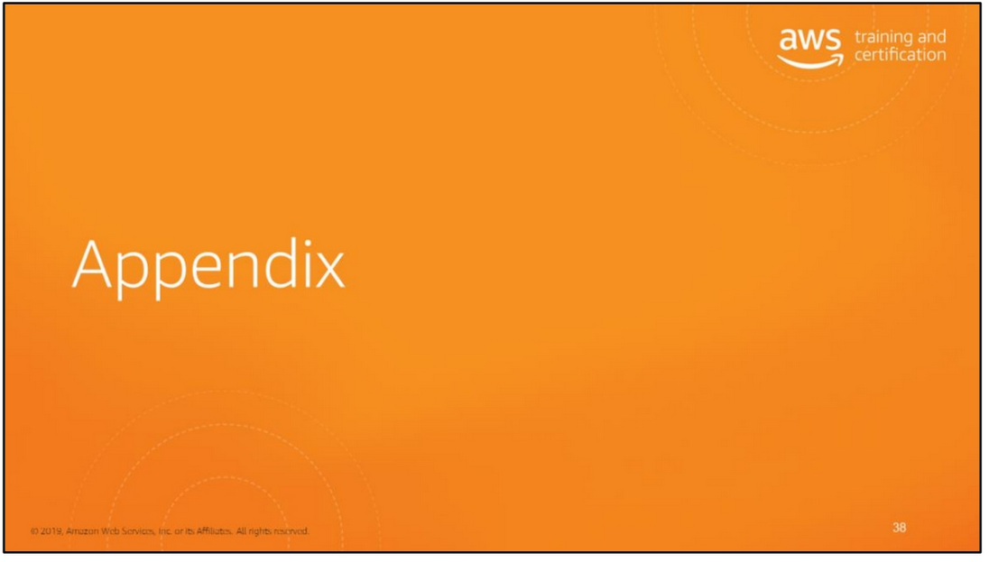

Slide 36
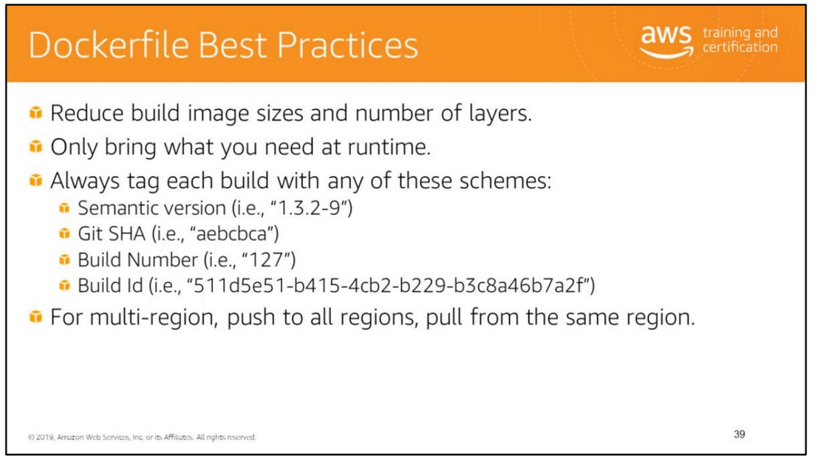
For Dockerfile writing best practices, see https://docs.docker.com/develop/develop-images/dockerfile_best-practices/#label

